Slide 1
Three GAPS Experiment
GAP Location: …..YSD-TAAN……… (Second Line)
….TTT-AAMA-SVH….. (Third line)

Slide 2
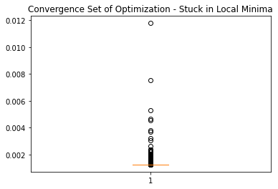
Three GAPS - MSE
Alignment of samples: 100%|██████████| 12000/12000 [06:40<00:00, 29.99iters/s, loss=0.0012459013378247619]

Slide 3
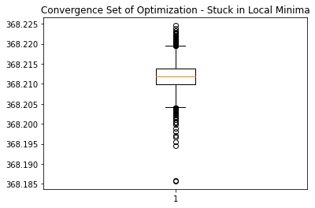
Three GAPS - Cross Entropy
Alignment of samples: 100%|██████████| 12000/12000 [06:49<00:00, 29.32iters/s, loss=368.213134765625]

Slide 4
Two GAPS Experiment
GAP Location: ….TTT-AAMA-SVH….. (Third line)

Slide 5
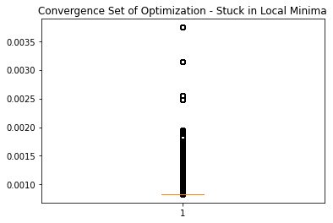
Two GAPS - MSE
Alignment of samples: 100%|██████████| 12000/12000 [06:46<00:00, 29.52iters/s, loss=0.0008306019008159637]

Slide 6

Two GAPS - Cross Entropy
Alignment of samples: 100%|██████████| 12000/12000 [06:50<00:00, 29.23iters/s, loss=367.2113952636719]

Slide 7
One GAP Experiment
GAP Location: ……..AAMA-SVH….. (Third line)

Slide 8
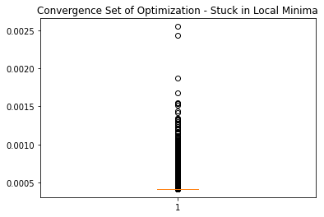
One GAP - MSE
Alignment of samples: 100%|██████████| 12000/12000 [07:09<00:00, 27.95iters/s, loss=0.00041557784425094724]

Slide 9

One GAP - Cross Entropy
Alignment of samples: 100%|██████████| 12000/12000 [07:12<00:00, 27.78iters/s, loss=366.2157897949219]

Slide 10
New Experiment
GAP Location: ……..AAMA--SVH….. (Third line, reference)
PADDING Location: -QLRELEST…….GAAXS- (input)

Slide 11
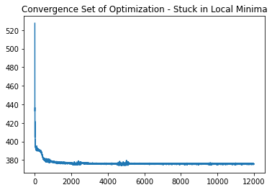
One GAP - CE
?
Alignment of samples: 100%|██████████| 12000/12000 [06:38<00:00, 30.11iters/s, loss=375.92138671875]

Slide 12
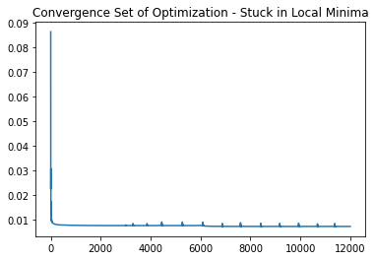
One GAP - MSE
Crash!!
Alignment of samples: 100%|██████████| 12000/12000 [06:32<00:00, 30.53iters/s, loss=0.007180311717092991]

Slide 14
Group Meeting
GAP Location: ……..AAMA--SVH….. (Third line, reference)
PADDING Location: QLRELEST…….GAAXS-- (input)

Slide 15
New Experiment
GAP Location: ……..AAMA--SVH….. (Third line, reference)
PADDING Location: QLRELEST…….GAAXS-- (input)

Slide 16
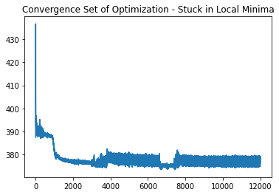
One GAP - CE
Alignment of samples: 100%|██████████| 12000/12000 [06:45<00:00, 29.57iters/s, loss=376.30877685546875]

Slide 17
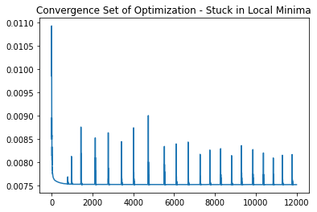
One GAP - MSE
Crash!!
Alignment of samples: 100%|██████████| 12000/12000 [06:44<00:00, 29.65iters/s, loss=0.007526818197220564]

Slide 18
Experiments GAP-PADDING
RAW SEQUENCE
ALIGNED / REFERENCE
CPAB

Slide 19
Experiments GAP-PADDING
RAW SEQUENCE
ALIGNED / REFERENCE
CPAB
?

Slide 20
Individual Meeting
November 11th 2021

Slide 21
1D visual phenomenom Transformation - CPAB
Raw Sequence
Reference - Gaps
CPAB - Best one
CPAB - Distributions around epochs

Slide 22
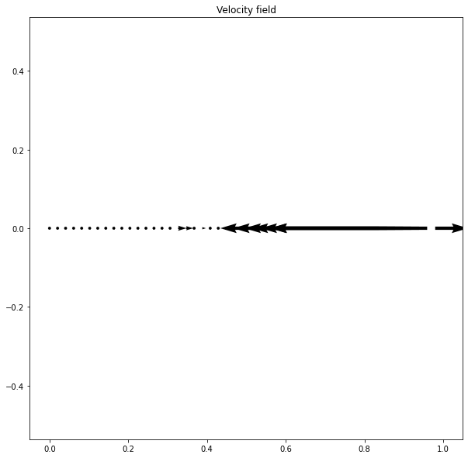
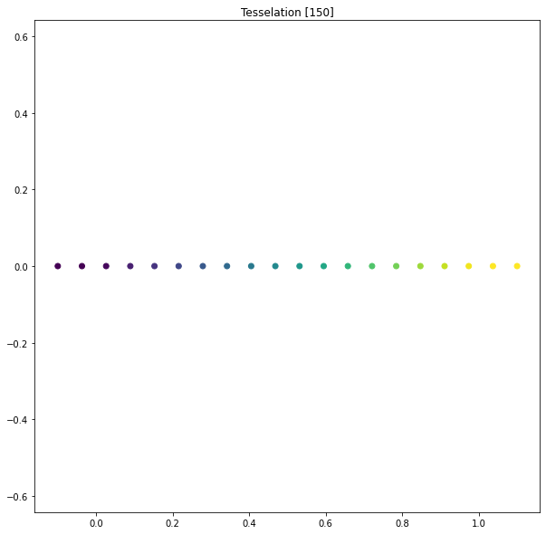
1D visual phenomenom Transformation - CPAB

Slide 23
Initial Sequence
tensor([14, 10, 15, 4, 10, 4, 16, 17, 5, 3, 6, 15, 10, 6, 5, 18, 1, 10,
3, 17, 1, 17, 6, 1, 15, 8, 1, 7, 15, 6, 3, 4, 15, 5, 13, 5,
2, 16, 17, 16, 9, 11, 11, 10, 2, 1, 1, 18, 10, 1, 15, 16, 1, 6,
4, 13, 1, 10, 10, 14, 15, 15, 8, 1, 19, 1, 9, 6, 3, 10, 8, 15,
19, 16, 13, 8, 17, 4, 14, 7, 18, 6, 1, 6, 11, 16, 18, 1, 4, 10,
2, 1, 1, 17, 10, 14, 19, 16, 3, 12, 17, 1, 1, 12, 10, 10, 8, 1,
10, 10, 6, 6, 13, 14, 1, 18, 17, 1, 19, 1, 15, 16, 8, 6, 3, 1,
17, 5, 15, 10, 3, 15, 15, 4, 13, 4, 10, 12, 17, 1, 10, 13, 6, 3,
4, 15, 3, 17, 17, 17, 13, 1, 1, 11, 1, 1, 16, 18, 7, 15, 10, 10,
18, 6, 3, 1, 10, 6, 1, 1, 16, 0, 0, 0], device='cuda:0')
Reference Sequence
tensor([14, 10, 15, 4, 10, 4, 16, 17, 5, 3, 6, 15, 10, 6, 5, 18, 1, 10,
3, 17, 1, 17, 6, 1, 15, 8, 1, 7, 15, 6, 3, 4, 15, 5, 13, 5,
2, 16, 17, 16, 9, 11, 11, 10, 2, 1, 1, 18, 10, 1, 15, 16, 1, 6,
4, 13, 1, 10, 10, 14, 15, 15, 8, 1, 19, 1, 9, 6, 3, 10, 8, 15,
19, 16, 13, 8, 17, 4, 14, 7, 18, 6, 1, 6, 11, 16, 18, 1, 4, 10,
2, 1, 1, 17, 10, 14, 19, 16, 3, 12, 17, 1, 1, 12, 10, 10, 8, 1,
10, 10, 6, 6, 13, 14, 1, 18, 17, 1, 19, 1, 15, 16, 8, 6, 3, 1,
17, 5, 15, 10, 3, 15, 15, 4, 13, 4, 10, 12, 17, 1, 10, 13, 6, 0,
3, 0, 4, 15, 3, 17, 17, 17, 13, 1, 1, 11, 1, 1, 0, 16, 18, 7,
15, 10, 10, 18, 6, 3, 1, 10, 6, 1, 1, 16], device='cuda:0')
Estimate by CPAB
tensor([14, 10, 15, 4, 10, 4, 16, 17, 5, 3, 6, 15, 10, 6, 5, 18, 1, 10,
3, 17, 1, 17, 6, 1, 15, 8, 1, 7, 15, 6, 3, 4, 15, 5, 13, 5,
2, 16, 17, 16, 9, 11, 11, 10, 2, 1, 1, 18, 10, 1, 15, 16, 1, 6,
4, 13, 1, 10, 10, 14, 15, 15, 8, 1, 19, 1, 9, 6, 3, 10, 8, 15,
19, 16, 13, 8, 17, 4, 14, 7, 18, 6, 1, 6, 11, 16, 18, 1, 4, 10,
2, 1, 1, 17, 10, 14, 19, 16, 3, 12, 17, 1, 1, 12, 10, 10, 8, 1,
10, 10, 6, 6, 13, 14, 1, 18, 17, 1, 19, 1, 15, 16, 8, 6, 3, 1,
17, 5, 15, 10, 3, 15, 15, 4, 13, 4, 10, 12, 17, 1, 10, 13, 6, 3,
3, 3, 4, 15, 3, 17, 17, 17, 13, 1, 1, 11, 1, 1, 1, 16, 18, 7,
15, 10, 10, 18, 6, 3, 1, 1, 16, 0, 0, 0], device='cuda:0')
THIS PART GOES TO HELL!!!!

Slide 24
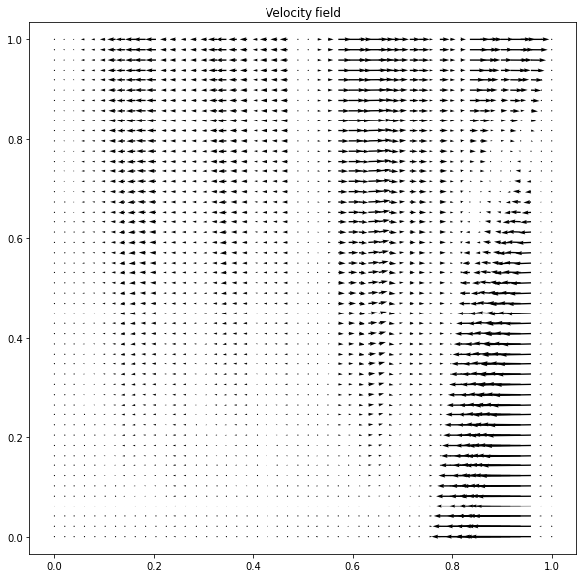
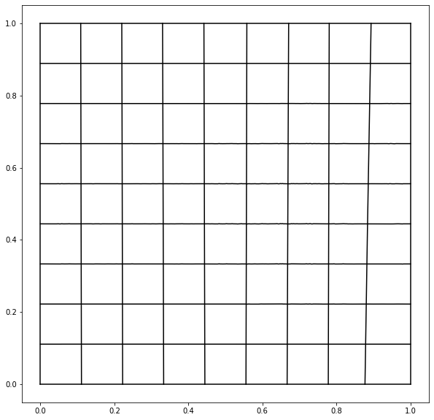
2D visual phenomenom Transformation - CPAB (Deformations only available in 2D)

Slide 25
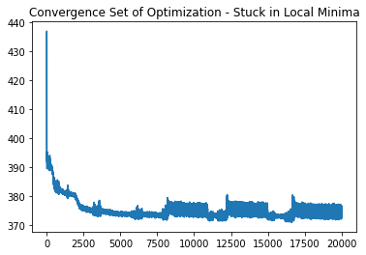
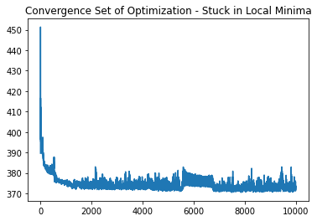
1D
2D

Slide 26
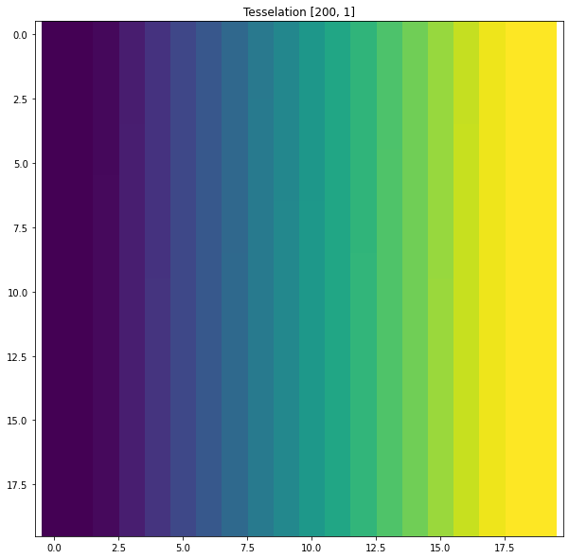

Slide 27
Observations
CPAB transformations react in the areas of intentional GAPS
Insensitivity at extremes of sequence
Still deformation of the signal (contraction) at the last region of the sequence due to the same phenomenon (see vector fields 2D)
Suspicion the Loss function is not enough instead of CPAB approach
tendency to get stuck in local minima
Strategies to deal with the problem
Use Variational Approach: https://arxiv.org/pdf/2106.08233.pdf ( pages 3-5):
Instead of using feature maps (Steffen and Aasa used VAE), we assume directly the raw samples (unexpected spatial transformation statement)
Assumption of fixed prior instead of a Learnable one
Use of CPAB transformation as our template (the paper assume unexpected transformation)
Metrics based on Optimal Transport (Reading in progress: http://remi.flamary.com/cours/tuto_otml.html)

Slide 28
1D visual phenomenom Transformation - CPAB, grid size = 174 (same as protein)
Raw Sequence
Reference - Gaps
CPAB - Best one
CPAB - Distributions around epochs

Slide 29
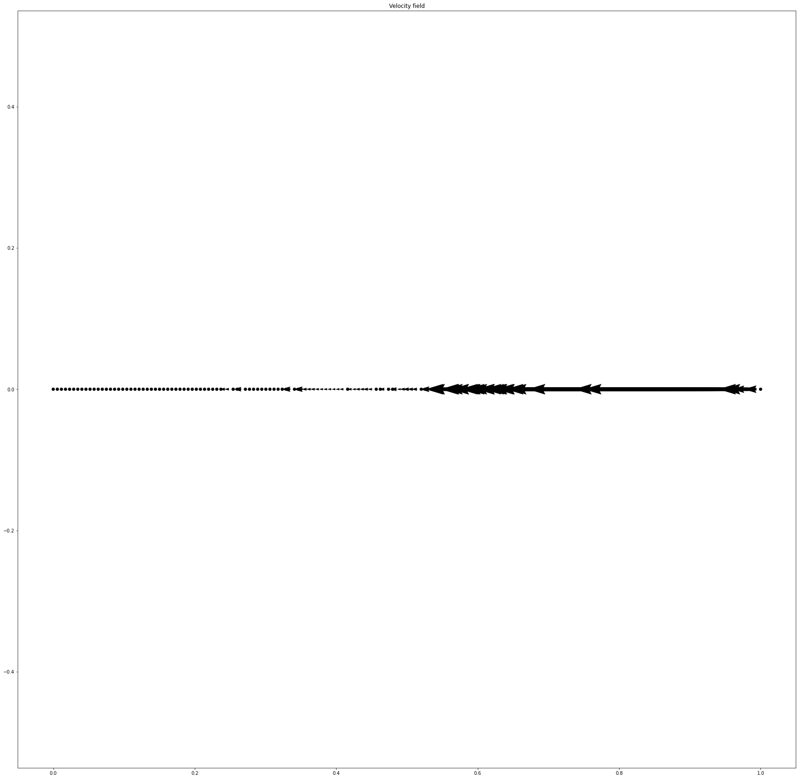
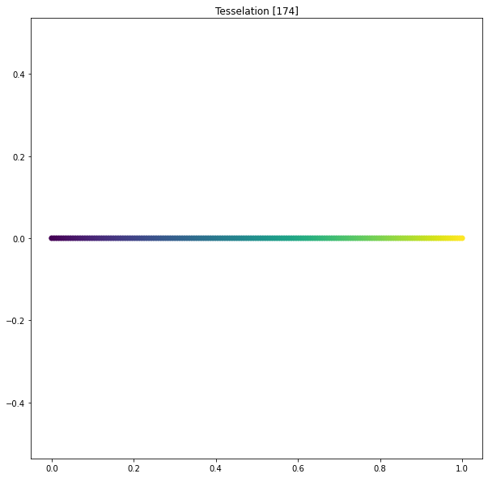
1D visual phenomenom Transformation - CPAB, grid size = 174 (same as protein)

Slide 30
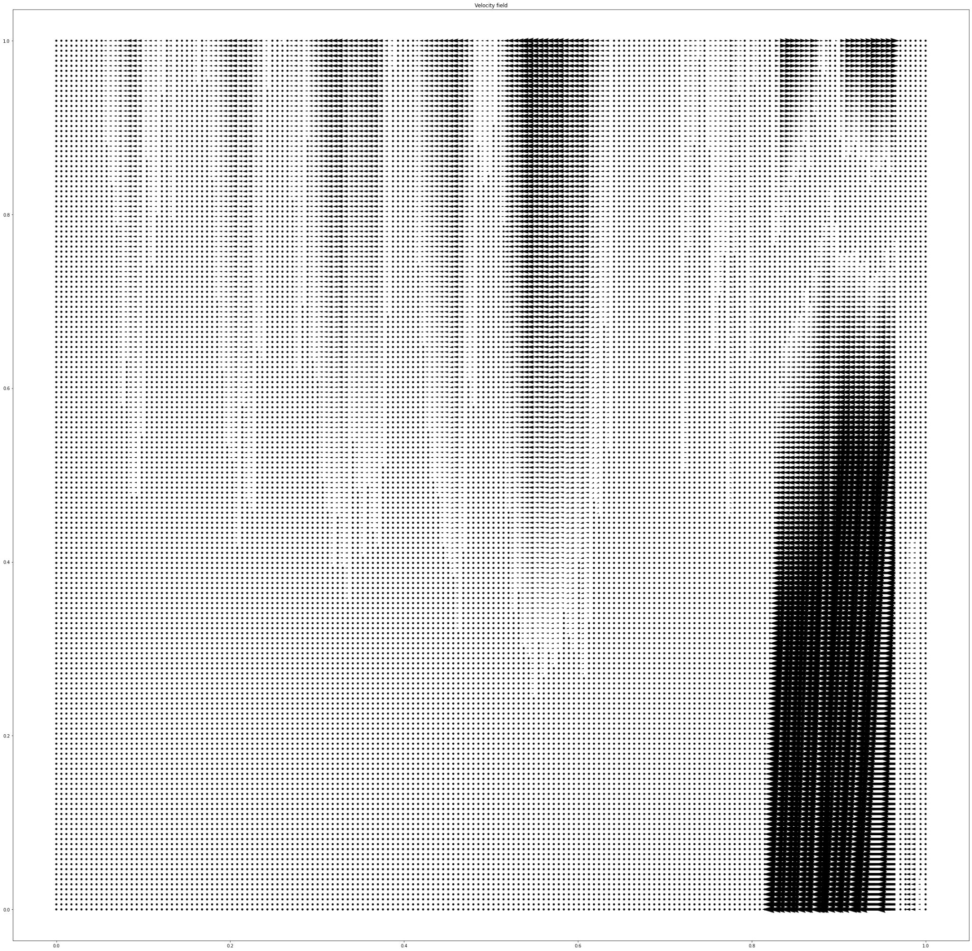
2D visual phenomenom Transformation - CPAB, grid size = 174 (same as protein)

Slide 31
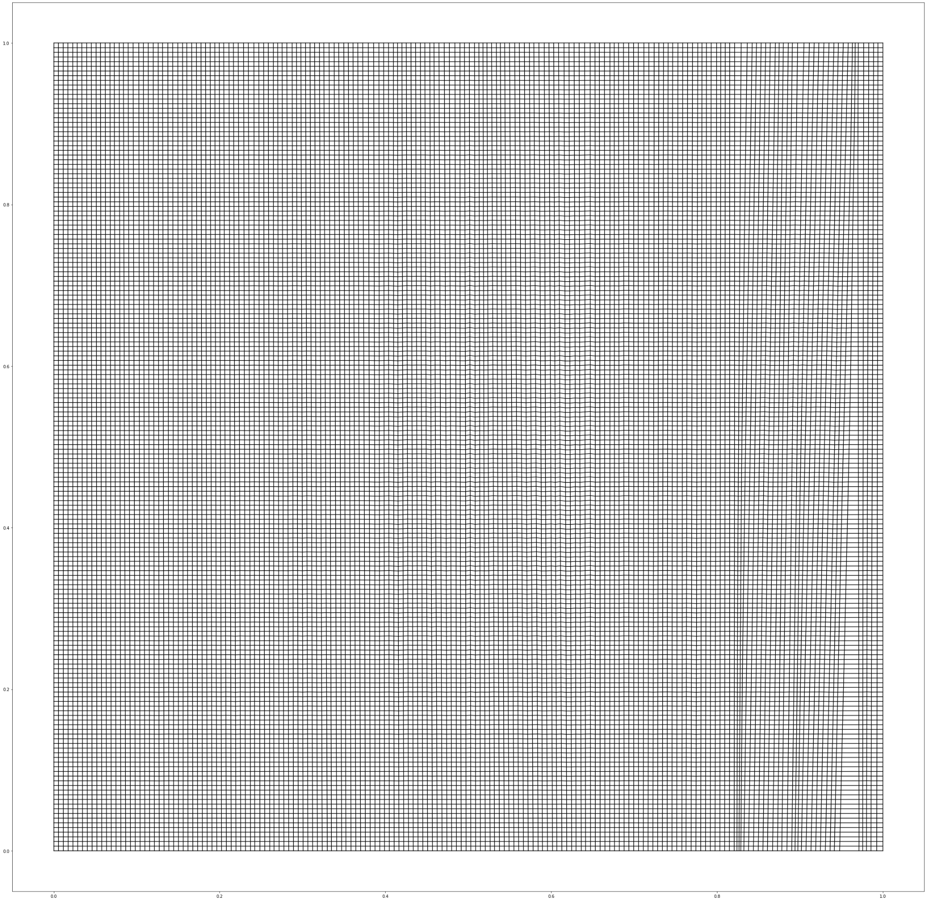
2D visual phenomenom Transformation - CPAB, grid size = 174 (same as protein)
Notes:
Seems like the defformations correspond to the changes/behaviors in the gaps and the disappeared aminoacids:
Conflicts:
170-174: remains equal (including the padding)
166-168: disappeared (vector field shows from position 166-169 in the grid) -> this should mean that despite that position in the sequence were not affected in change (not affected the one hot encoding), in the continues space it actually change
159: Gap behavior (but affected in position 156-159 in vector field)
144,146: Gap behavior
Probably there are include some of the neighbors because the vector field must be differentiable, so slight changes should be shown in the grid from vector field.

Slide 32
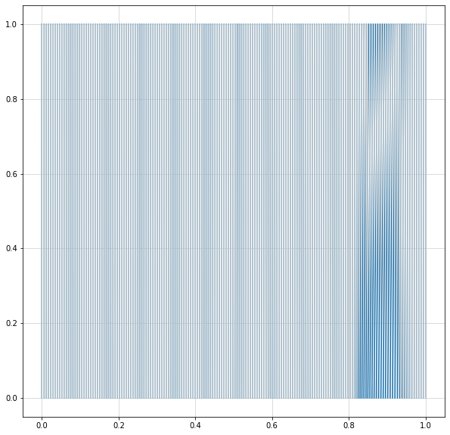
2D visual phenomenom Transformation - CPAB, grid size = 174 (same as protein)

Slide 34
Squeezing Proteins with CPAB / Meeting
November 15th 2021

Slide 35
Experimental Setup

Slide 36
SELF-SEQUENCE ALIGNMENT BY DIFFEOMORPHIC TRANSFORMATIONS
Goal: To determine feasibility of Learning the representation of theta to align raw sequence via spatial transformation
S1
Protein 1 (Raw) (S1)
Learn for Vector Field Integration: Optimize
Spatial Transformer
Reference (S2)
Reference: Same Raw Protein, but adding artificial gaps, simulating a sequence alignment output
Aligned Seq or S2

Slide 37
Example 1

Slide 38
1D visual phenomenom Transformation - CPAB, grid size = 174 (same as protein)
Raw Sequence
Reference - Gaps
CPAB - Best one
CPAB - Distributions around epochs

Slide 39
Initial Sequence
tensor([14, 10, 15, 4, 10, 4, 16, 17, 5, 3, 6, 15, 10, 6, 5, 18, 1, 10,
3, 17, 1, 17, 6, 1, 15, 8, 1, 7, 15, 6, 3, 4, 15, 5, 13, 5,
2, 16, 17, 16, 9, 11, 11, 10, 2, 1, 1, 18, 10, 1, 15, 16, 1, 6,
4, 13, 1, 10, 10, 14, 15, 15, 8, 1, 19, 1, 9, 6, 3, 10, 8, 15,
19, 16, 13, 8, 17, 4, 14, 7, 18, 6, 1, 6, 11, 16, 18, 1, 4, 10,
2, 1, 1, 17, 10, 14, 19, 16, 3, 12, 17, 1, 1, 12, 10, 10, 8, 1,
10, 10, 6, 6, 13, 14, 1, 18, 17, 1, 19, 1, 15, 16, 8, 6, 3, 1,
17, 5, 15, 10, 3, 15, 15, 4, 13, 4, 10, 12, 17, 1, 10, 13, 6, 3,
4, 15, 3, 17, 17, 17, 13, 1, 1, 11, 1, 1, 16, 18, 7, 15, 10, 10,
18, 6, 3, 1, 10, 6, 1, 1, 16, 0, 0, 0], device='cuda:0')
Reference Sequence
tensor([14, 10, 15, 4, 10, 4, 16, 17, 5, 3, 6, 15, 10, 6, 5, 18, 1, 10,
3, 17, 1, 17, 6, 1, 15, 8, 1, 7, 15, 6, 3, 4, 15, 5, 13, 5,
2, 16, 17, 16, 9, 11, 11, 10, 2, 1, 1, 18, 10, 1, 15, 16, 1, 6,
4, 13, 1, 10, 10, 14, 15, 15, 8, 1, 19, 1, 9, 6, 3, 10, 8, 15,
19, 16, 13, 8, 17, 4, 14, 7, 18, 6, 1, 6, 11, 16, 18, 1, 4, 10,
2, 1, 1, 17, 10, 14, 19, 16, 3, 12, 17, 1, 1, 12, 10, 10, 8, 1,
10, 10, 6, 6, 13, 14, 1, 18, 17, 1, 19, 1, 15, 16, 8, 6, 3, 1,
17, 5, 15, 10, 3, 15, 15, 4, 13, 4, 10, 12, 17, 1, 10, 13, 6, 0,
3, 0, 4, 15, 3, 17, 17, 17, 13, 1, 1, 11, 1, 1, 0, 16, 18, 7,
15, 10, 10, 18, 6, 3, 1, 10, 6, 1, 1, 16], device='cuda:0')
Estimate by CPAB
tensor([14, 10, 15, 4, 10, 4, 16, 17, 5, 3, 6, 15, 10, 6, 5, 18, 1, 10,
3, 17, 1, 17, 6, 1, 15, 8, 1, 7, 15, 6, 3, 4, 15, 5, 13, 5,
2, 16, 17, 16, 9, 11, 11, 10, 2, 1, 1, 18, 10, 1, 15, 16, 1, 6,
4, 13, 1, 10, 10, 14, 15, 15, 8, 1, 19, 1, 9, 6, 3, 10, 8, 15,
19, 16, 13, 8, 17, 4, 14, 7, 18, 6, 1, 6, 11, 16, 18, 1, 4, 10,
2, 1, 1, 17, 10, 14, 19, 16, 3, 12, 17, 1, 1, 12, 10, 10, 8, 1,
10, 10, 6, 6, 13, 14, 1, 18, 17, 1, 19, 1, 15, 16, 8, 6, 3, 1,
17, 5, 15, 10, 3, 15, 15, 4, 13, 4, 10, 12, 17, 1, 10, 13, 6, 3,
3, 3, 4, 15, 3, 17, 17, 17, 13, 1, 1, 11, 1, 1, 1, 16, 18, 7,
15, 10, 10, 18, 6, 3, 1, 1, 16, 0, 0, 0], device='cuda:0')
THIS PART GOES TO HELL!!!!

Slide 40
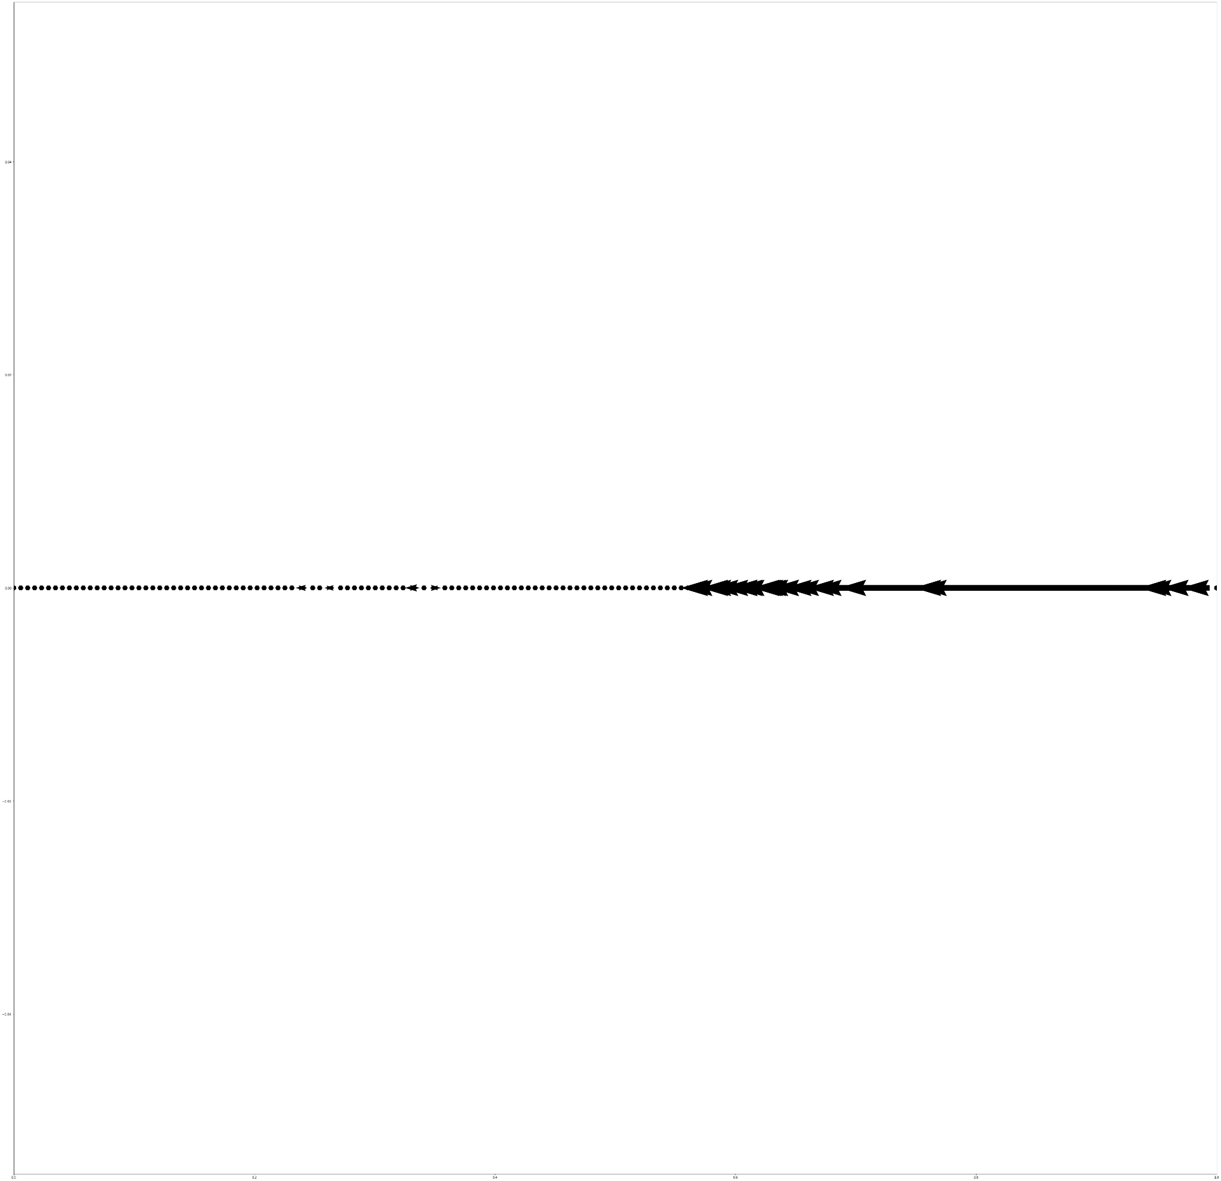

Slide 41
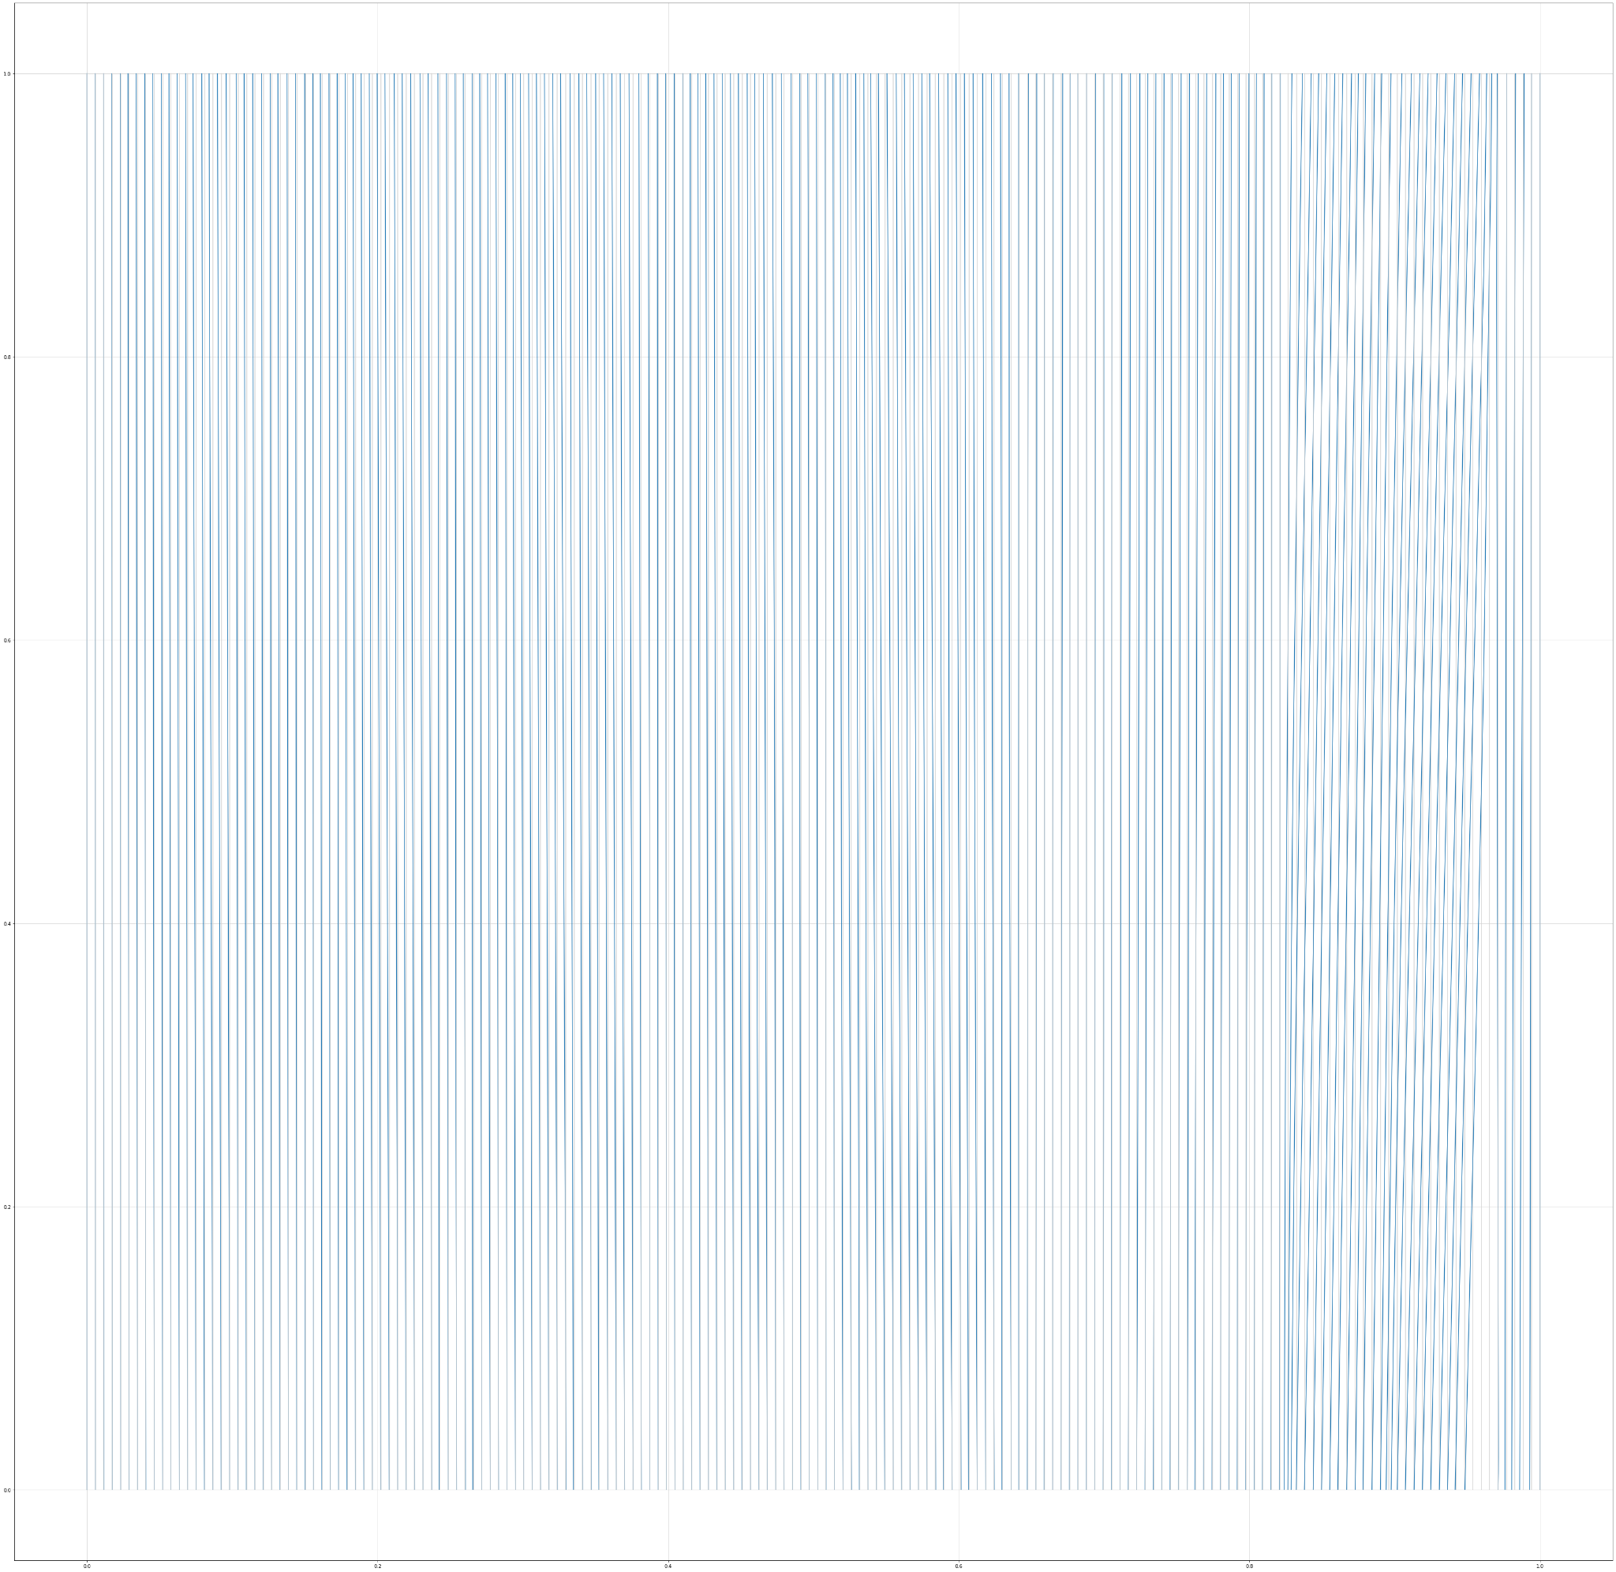

Slide 42

Ref

Slide 43
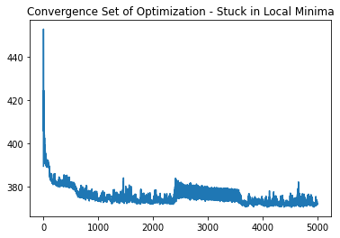

Slide 44
Example 2

Slide 45
1D visual phenomenom Transformation - CPAB, grid size = 174 (same as protein)
Raw Sequence
Reference - Gaps
174-31-61
174-31
CPAB - Best one
???
CPAB - Distributions around epochs

Slide 46
Initial Sequence
Initial Sequence
tensor([14, 10, 15, 4, 10, 4, 16, 17, 5, 3, 6, 15, 10, 6, 5, 18, 1, 10,
3, 17, 1, 17, 6, 1, 15, 8, 1, 7, 15, 6, 3, 4, 15, 5, 13, 5,
2, 16, 17, 16, 9, 11, 11, 10, 2, 1, 1, 18, 10, 1, 15, 16, 1, 6,
4, 13, 1, 10, 10, 14, 15, 15, 8, 1, 19, 1, 9, 6, 3, 10, 8, 15,
19, 16, 13, 8, 17, 4, 14, 7, 18, 6, 1, 6, 11, 16, 18, 1, 4, 10,
2, 1, 1, 17, 10, 14, 19, 16, 3, 12, 17, 1, 1, 12, 10, 10, 8, 1,
10, 10, 6, 6, 13, 14, 1, 18, 17, 1, 19, 1, 15, 16, 8, 6, 3, 1,
17, 5, 15, 10, 3, 15, 15, 4, 13, 4, 10, 12, 17, 1, 10, 13, 6, 3,
4, 15, 3, 17, 17, 17, 13, 1, 1, 11, 1, 1, 16, 18, 7, 15, 10, 10,
18, 6, 3, 1, 10, 6, 1, 1, 16, 0, 0, 0])
Reference Sequence
tensor([14, 10, 15, 4, 10, 4, 16, 17, 5, 3, 6, 15, 10, 6, 5, 18, 1, 10,
3, 0, 17, 1, 17, 6, 1, 15, 8, 1, 7, 15, 6, 3, 4, 15, 5, 13,
5, 2, 16, 17, 16, 9, 11, 11, 10, 2, 1, 1, 18, 10, 1, 15, 16, 1,
6, 4, 13, 1, 10, 10, 14, 15, 15, 8, 1, 19, 1, 9, 6, 3, 10, 8,
15, 19, 16, 13, 8, 17, 4, 14, 7, 18, 0, 6, 1, 6, 11, 16, 18, 1,
4, 10, 2, 1, 1, 17, 10, 14, 19, 16, 3, 12, 17, 1, 1, 12, 10, 10,
8, 1, 10, 10, 6, 6, 13, 14, 1, 18, 17, 1, 19, 1, 15, 16, 8, 6,
3, 1, 17, 5, 15, 10, 3, 15, 15, 4, 13, 4, 10, 12, 17, 1, 10, 0,
13, 6, 3, 4, 15, 3, 17, 17, 17, 13, 1, 1, 11, 1, 1, 16, 18, 7,
15, 10, 10, 18, 6, 3, 1, 10, 6, 1, 1, 16])
Estimate by CPAB
tensor([14, 10, 15, 4, 10, 4, 16, 17, 5, 3, 6, 15, 10, 6, 5, 18, 1, 10,
3, 3, 17, 1, 17, 6, 1, 15, 8, 1, 7, 15, 6, 3, 4, 15, 5, 13,
5, 2, 16, 17, 16, 9, 11, 11, 10, 2, 1, 1, 18, 10, 1, 15, 16, 1,
6, 4, 13, 1, 10, 10, 14, 15, 15, 8, 1, 19, 1, 9, 6, 3, 10, 8,
15, 19, 16, 13, 8, 17, 4, 14, 7, 18, 18, 6, 1, 6, 11, 16, 18, 1,
4, 10, 2, 1, 1, 17, 10, 14, 19, 16, 3, 12, 17, 1, 1, 12, 10, 10,
8, 1, 10, 10, 6, 6, 13, 14, 1, 18, 17, 1, 19, 1, 15, 16, 8, 6,
3, 1, 17, 5, 15, 10, 3, 15, 15, 4, 13, 4, 10, 12, 17, 1, 10, 13,
13, 6, 3, 4, 15, 3, 17, 17, 17, 13, 1, 1, 16, 18, 18, 7, 10, 10,
18, 18, 6, 3, 10, 6, 1, 1, 16, 0, 0, 0])
THIS PART GOES TO HELL!!!!

Slide 47
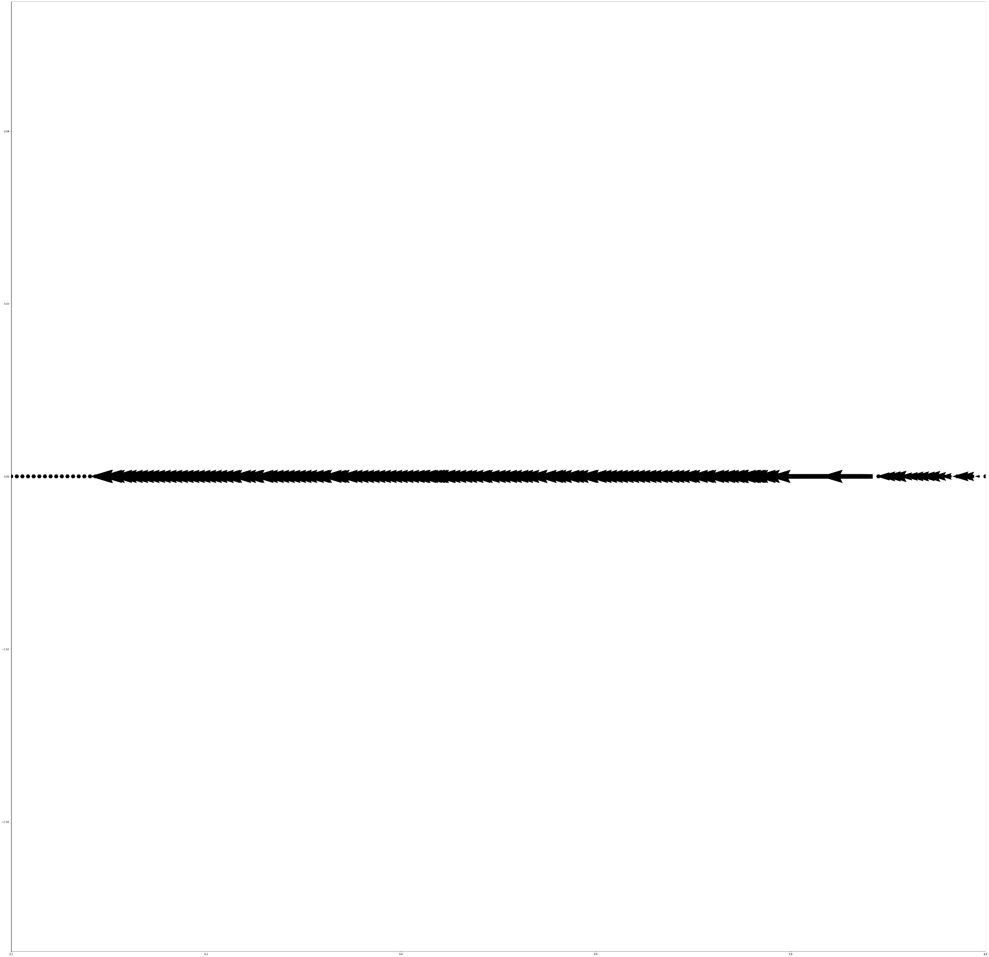

Slide 48
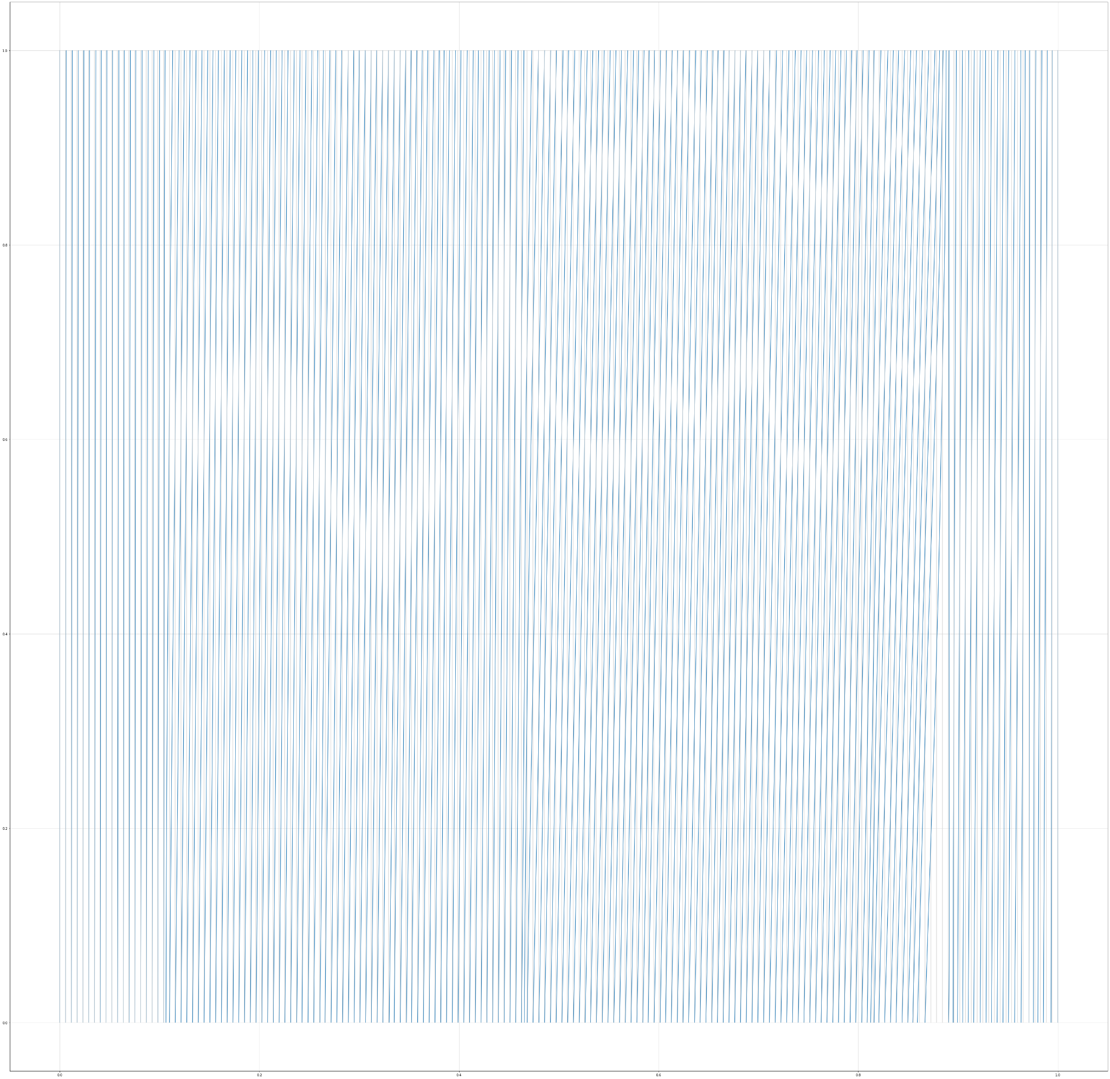


Slide 49
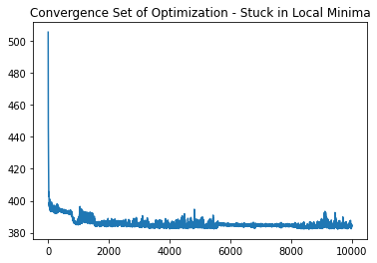

Slide 50
Appendix

Slide 51
Experiments GAP-PADDING
RAW SEQUENCE
ALIGNED / REFERENCE
CPAB

Slide 53
Individual Meeting
November 19th 2021

Slide 54
Example 3- Eliminating Padding

Slide 55
1D visual phenomenom Transformation - CPAB, grid size = 174 (same as protein)
Raw Sequence
Reference - Gaps
174-31-61
174-31
CPAB - Best one
CPAB - Distributions around epochs

Slide 56
Initial Sequence
([14, 10, 15, 4, 10, 4, 16, 17, 5, 3, 6, 15, 10, 6, 5, 18, 1, 10,
3, 17, 1, 17, 6, 1, 15, 8, 1, 7, 15, 6, 3, 4, 15, 5, 13, 5,
2, 16, 17, 16, 9, 11, 11, 10, 2, 1, 1, 18, 10, 1, 15, 16, 1, 6,
4, 13, 1, 10, 10, 14, 15, 15, 8, 1, 19, 1, 9, 6, 3, 10, 8, 15,
19, 16, 13, 8, 17, 4, 14, 7, 18, 6, 1, 6, 11, 16, 18, 1, 4, 10,
2, 1, 1, 17, 10, 14, 19, 16, 3, 12, 17, 1, 1, 12, 10, 10, 8, 1,
10, 10, 6, 6, 13, 14, 1, 18, 17, 1, 19, 1, 15, 16, 8, 6, 3, 1,
17, 5, 15, 10, 3, 15, 15, 4, 13, 4, 10, 12, 17, 1, 10, 13, 6, 3,
4, 15, 3, 17, 17, 17, 13, 1, 1, 11, 1, 1, 16, 18, 7, 15, 10, 10,
18, 6, 3, 1, 10, 6, 1, 1, 16])
Reference Sequence
([14, 10, 15, 4, 10, 4, 16, 17, 5, 3, 6, 15, 10, 6, 5, 18, 1, 10,
3, 0, 17, 1, 17, 6, 1, 15, 8, 1, 7, 15, 6, 3, 4, 15, 5, 13,
5, 2, 16, 17, 16, 9, 11, 11, 10, 2, 1, 1, 18, 10, 1, 15, 16, 1,
6, 4, 13, 1, 10, 10, 14, 15, 15, 8, 1, 19, 1, 9, 6, 3, 10, 8,
15, 19, 16, 13, 8, 17, 4, 14, 7, 18, 0, 6, 1, 6, 11, 16, 18, 1,
4, 10, 2, 1, 1, 17, 10, 14, 19, 16, 3, 12, 17, 1, 1, 12, 10, 10,
8, 1, 10, 10, 6, 6, 13, 14, 1, 18, 17, 1, 19, 1, 15, 16, 8, 6,
3, 1, 17, 5, 15, 10, 3, 15, 15, 4, 13, 4, 10, 12, 17, 1, 10, 0,
13, 6, 3, 4, 15, 3, 17, 17, 17, 13, 1, 1, 11, 1, 1, 16, 18, 7,
15, 10, 10, 18, 6, 3, 1, 10, 6, 1, 1, 16])
Estimate by CPAB
tensor([14, 10, 15, 4, 10, 4, 16, 17, 5, 3, 6, 15, 10, 6, 5, 18, 1, 10,
3, 3, 17, 1, 17, 6, 1, 15, 8, 1, 7, 15, 6, 3, 4, 15, 5, 13,
5, 2, 16, 17, 16, 9, 11, 11, 10, 2, 1, 1, 18, 10, 1, 15, 16, 1,
6, 4, 13, 1, 10, 10, 14, 15, 15, 8, 1, 19, 1, 9, 6, 3, 10, 8,
15, 19, 16, 13, 8, 17, 4, 14, 7, 18, 6, 6, 1, 6, 11, 16, 18, 1,
4, 10, 2, 1, 1, 17, 10, 14, 19, 16, 3, 12, 17, 1, 1, 12, 10, 10,
8, 1, 10, 10, 6, 6, 13, 14, 1, 18, 17, 1, 19, 1, 15, 16, 8, 6,
3, 1, 17, 5, 15, 10, 3, 15, 15, 4, 13, 4, 10, 12, 17, 1, 10, 10,
13, 6, 3, 4, 15, 3, 17, 17, 17, 13, 1, 1, 11, 1, 1, 16, 18, 7,
15, 10, 10, 18, 6, 3, 1, 10, 6, 1, 1, 16])

Slide 57
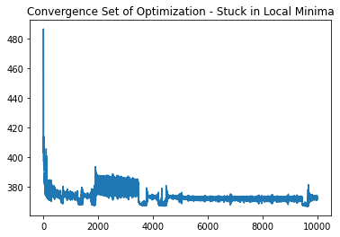

Slide 58
1D visual phenomenom Transformation - CPAB, grid size = 174 (same as protein)
Raw Sequence
Reference - Gaps
CPAB - Best one
CPAB - Distributions around epochs

Slide 59
Initial Sequence
tensor([14, 10, 15, 4, 10, 4, 16, 17, 5, 3, 6, 15, 10, 6, 5, 18, 1, 10,
3, 17, 1, 17, 6, 1, 15, 8, 1, 7, 15, 6, 3, 4, 15, 5, 13, 5,
2, 16, 17, 16, 9, 11, 11, 10, 2, 1, 1, 18, 10, 1, 15, 16, 1, 6,
4, 13, 1, 10, 10, 14, 15, 15, 8, 1, 19, 1, 9, 6, 3, 10, 8, 15,
19, 16, 13, 8, 17, 4, 14, 7, 18, 6, 1, 6, 11, 16, 18, 1, 4, 10,
2, 1, 1, 17, 10, 14, 19, 16, 3, 12, 17, 1, 1, 12, 10, 10, 8, 1,
10, 10, 6, 6, 13, 14, 1, 18, 17, 1, 19, 1, 15, 16, 8, 6, 3, 1,
17, 5, 15, 10, 3, 15, 15, 4, 13, 4, 10, 12, 17, 1, 10, 13, 6, 3,
4, 15, 3, 17, 17, 17, 13, 1, 1, 11, 1, 1, 16, 18, 7, 15, 10, 10,
18, 6, 3, 1, 10, 6, 1, 1, 16])
Reference Sequence
tensor([ 0, 0, 14, 10, 15, 4, 10, 4, 16, 17, 5, 3, 6, 15, 10, 6, 5, 18,
1, 10, 3, 0, 17, 1, 17, 6, 1, 15, 8, 1, 7, 15, 6, 3, 4, 15,
5, 13, 5, 2, 16, 17, 16, 9, 11, 11, 10, 2, 1, 1, 18, 10, 1, 15,
16, 1, 6, 4, 13, 1, 10, 10, 14, 15, 15, 8, 1, 19, 1, 9, 6, 3,
10, 8, 15, 19, 16, 13, 8, 17, 4, 14, 7, 18, 0, 6, 1, 6, 11, 16,
18, 1, 4, 10, 2, 1, 1, 17, 10, 14, 19, 16, 3, 12, 17, 1, 1, 12,
10, 10, 8, 1, 10, 10, 6, 6, 13, 14, 1, 18, 17, 1, 19, 1, 15, 16,
8, 6, 3, 1, 17, 5, 15, 10, 3, 15, 15, 4, 13, 4, 10, 12, 17, 1,
10, 0, 13, 6, 3, 4, 15, 3, 17, 17, 17, 13, 1, 1, 11, 1, 1, 16,
18, 7, 15, 10, 10, 18, 6, 3, 1, 10, 6, 1, 1, 16, 0, 0])
Estimate by CPAB
tensor([14, 14, 14, 10, 15, 4, 10, 4, 16, 17, 5, 3, 6, 15, 10, 6, 5, 18,
1, 10, 3, 3, 17, 1, 17, 6, 1, 15, 8, 1, 7, 15, 6, 3, 4, 15,
5, 13, 5, 2, 16, 17, 16, 9, 11, 11, 10, 2, 1, 1, 18, 10, 1, 15,
16, 1, 6, 4, 13, 1, 10, 10, 14, 15, 15, 8, 1, 19, 1, 9, 6, 3,
10, 8, 15, 19, 16, 13, 8, 17, 4, 14, 7, 18, 6, 6, 1, 6, 11, 16,
18, 1, 4, 10, 2, 1, 1, 17, 10, 14, 19, 16, 3, 12, 17, 1, 1, 12,
10, 10, 8, 1, 10, 10, 6, 6, 13, 14, 1, 18, 17, 1, 19, 1, 15, 16,
8, 6, 3, 1, 17, 5, 15, 10, 3, 15, 15, 4, 13, 4, 10, 12, 17, 1,
10, 13, 13, 6, 3, 4, 15, 3, 17, 17, 17, 13, 1, 1, 11, 1, 1, 16,
18, 7, 15, 10, 10, 18, 6, 3, 1, 10, 6, 1, 1, 16, 16, 16])

Slide 60
Experiments GAP-PADDING
RAW SEQUENCE
ALIGNED / REFERENCE
CPAB
LOGOS

Slide 61
Estimate by CPAB
tensor([14, 10, 15, 4, 10, 4, 16, 17, 5, 3, 6, 15, 10, 6, 5, 18, 1, 10,
3, 17, 17, 1, 17, 6, 1, 15, 8, 1, 7, 15, 6, 3, 4, 15, 5, 13,
5, 2, 16, 17, 16, 9, 11, 11, 10, 2, 1, 1, 18, 10, 1, 15, 16, 1,
6, 4, 13, 1, 10, 10, 14, 15, 15, 8, 1, 19, 1, 9, 6, 3, 10, 8,
15, 19, 16, 13, 8, 17, 4, 14, 7, 18, 6, 6, 1, 6, 11, 16, 18, 1,
4, 10, 2, 1, 1, 17, 10, 14, 19, 16, 3, 12, 12, 12, 12, 12, 17, 1,
1, 12, 10, 10, 8, 8, 1, 10, 10, 6, 13, 13, 14, 1, 18, 18, 17, 19,
19, 1, 15, 16, 8, 6, 3, 1, 17, 17, 15, 15, 10, 3, 3, 15, 15, 13,
4, 10, 10, 12, 17, 1, 10, 10, 13, 6, 3, 4, 15, 3, 17, 17, 17, 13,
1, 1, 11, 1, 1, 16, 18, 7, 15, 10, 10, 18, 6, 3, 1, 10, 6, 1,
1, 16], device='cuda:0')
Initial Sequence
tensor([14, 10, 15, 4, 10, 4, 16, 17, 5, 3, 6, 15, 10, 6, 5, 18, 1, 10,
3, 17, 1, 17, 6, 1, 15, 8, 1, 7, 15, 6, 3, 4, 15, 5, 13, 5,
2, 16, 17, 16, 9, 11, 11, 10, 2, 1, 1, 18, 10, 1, 15, 16, 1, 6,
4, 13, 1, 10, 10, 14, 15, 15, 8, 1, 19, 1, 9, 6, 3, 10, 8, 15,
19, 16, 13, 8, 17, 4, 14, 7, 18, 6, 1, 6, 11, 16, 18, 1, 4, 10,
2, 1, 1, 17, 10, 14, 19, 16, 3, 12, 17, 1, 1, 12, 10, 10, 8, 1,
10, 10, 6, 6, 13, 14, 1, 18, 17, 1, 19, 1, 15, 16, 8, 6, 3, 1,
17, 5, 15, 10, 3, 15, 15, 4, 13, 4, 10, 12, 17, 1, 10, 13, 6, 3,
4, 15, 3, 17, 17, 17, 13, 1, 1, 11, 1, 1, 16, 18, 7, 15, 10, 10,
18, 6, 3, 1, 10, 6, 1, 1, 16], device='cuda:0')
Reference Sequence
tensor([14, 10, 15, 4, 10, 4, 16, 17, 5, 3, 6, 15, 10, 6, 5, 18, 1, 10,
3, 0, 17, 1, 17, 6, 1, 15, 8, 1, 7, 15, 6, 3, 4, 15, 5, 13,
5, 2, 16, 17, 16, 9, 11, 11, 10, 2, 1, 1, 18, 10, 1, 15, 16, 1,
6, 4, 13, 1, 10, 10, 14, 15, 15, 8, 1, 19, 1, 9, 6, 3, 10, 8,
15, 19, 16, 13, 8, 17, 4, 14, 7, 18, 0, 6, 1, 6, 11, 16, 18, 1,
4, 10, 2, 1, 1, 17, 10, 14, 19, 16, 3, 12, 17, 1, 1, 12, 10, 10,
8, 1, 10, 10, 6, 6, 13, 14, 1, 18, 17, 1, 19, 1, 15, 16, 8, 6,
3, 1, 17, 5, 15, 10, 3, 15, 15, 4, 13, 4, 10, 0, 0, 0, 0, 0,
0, 0, 0, 12, 17, 1, 10, 0, 13, 6, 3, 4, 15, 3, 17, 17, 17, 13,
1, 1, 11, 1, 1, 16, 18, 7, 15, 10, 10, 18, 6, 3, 1, 10, 6, 1,
1, 16], device='cuda:0')

